Slide 1





Hot Mess or Cool Tech?
Secrets to success for advanced building controls integration
Nathan Hinkle – Associate
ACEEE Summer Study in Buildings 2022

Slide 2





The Potential for Controls
HVAC, lighting, and plug loads
dominate commercial energy end-use
And most large buildings have a BMS
57%
But <1% have a networked lighting control system with luminaire-level lighting controls
Notes:
15% of commercial buildings have “EMS” lighting, <1% have NLC/LLLC. Some of this controls integration could be done w/ traditional “EMS” lighting controls, but occupancy sensors often lack the granularity, flexibility, and data connections needed. All studied in this project were LLLC w/ NLC.
25% heating, 9% cooling, 10% ventilation, 10% lighting, 2% office equipment

Slide 3
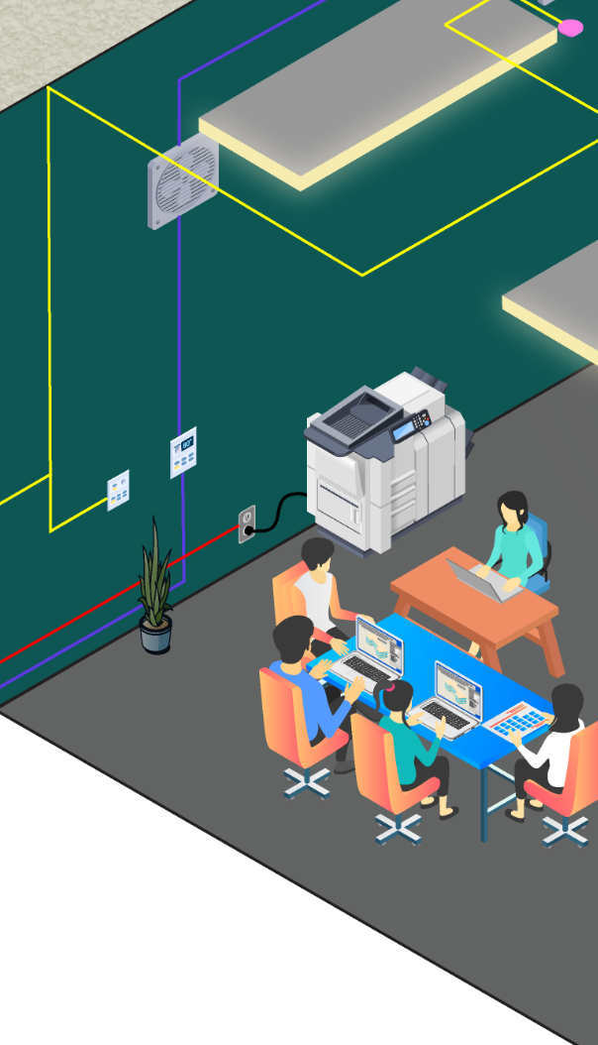
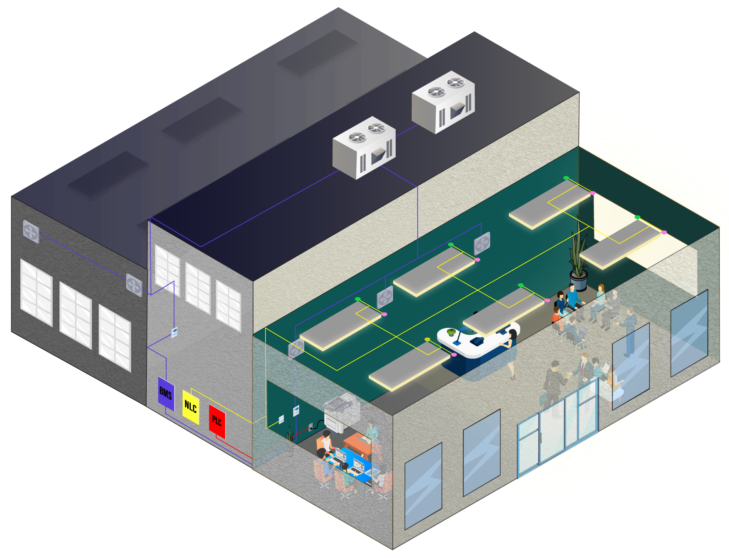
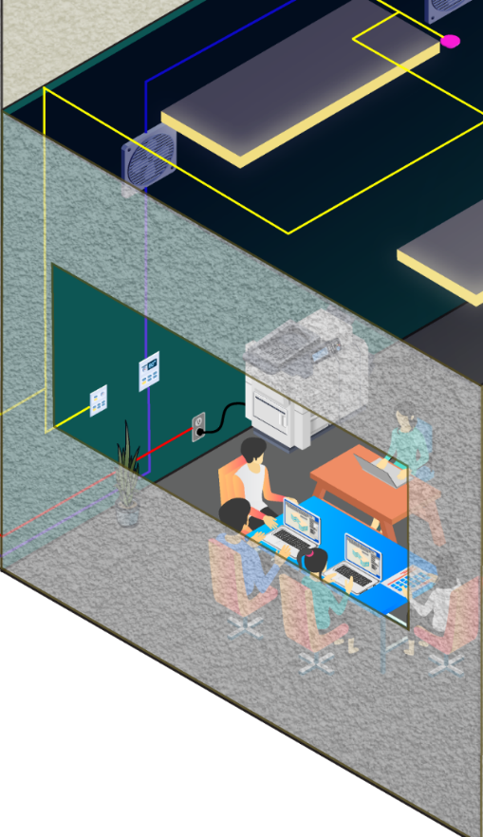
Controls Integration Concepts

Slide 4

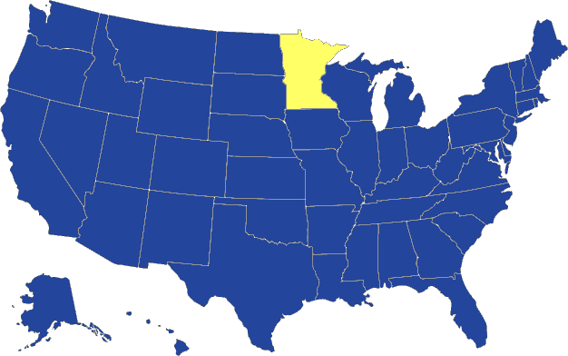




Controls Integration Pilot Study
Locations
Existing building retrofit measures
New LED fixtures
A: University admissions building
Occupancy + daylight sensors
NLC system
B: Municipal traffic operations center
C: Mixed use
office tower
HVAC control integration
Receptacle controllers
D: Outpatient healthcare facility
E: Transportation maintenance station

Slide 5
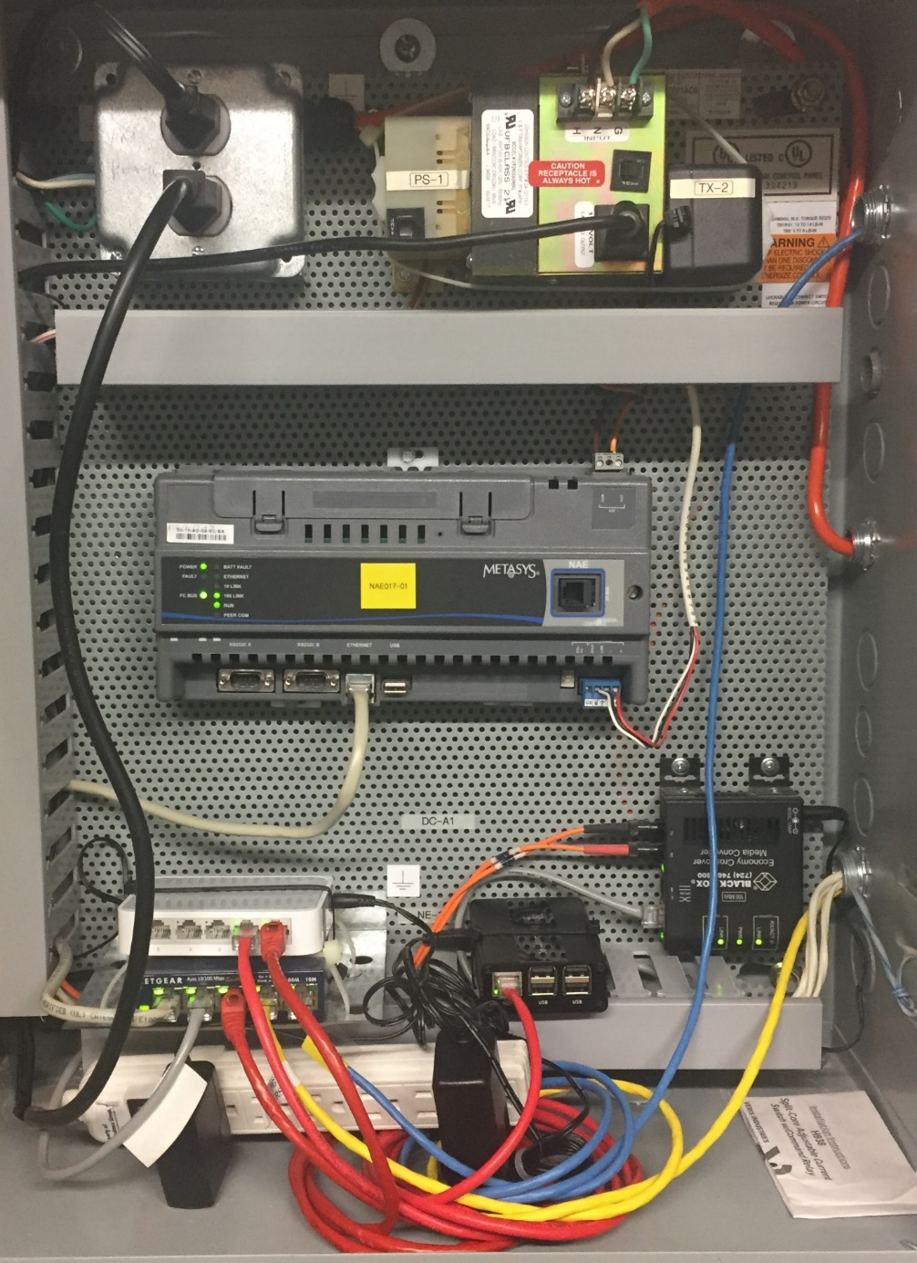
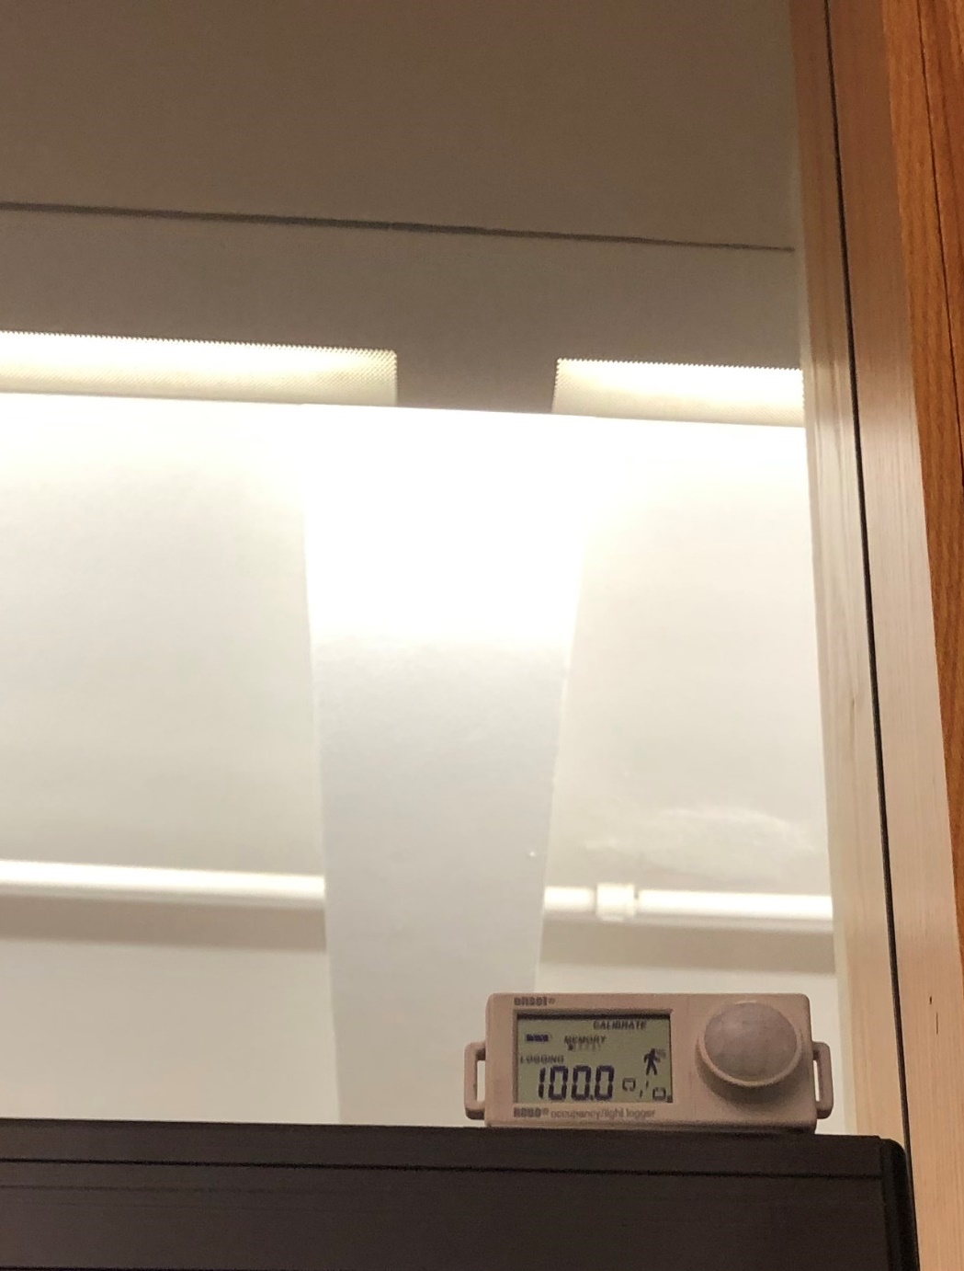
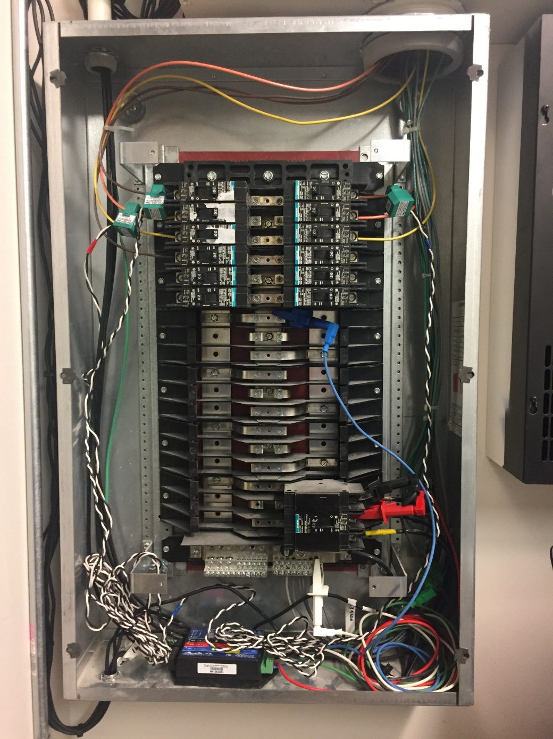
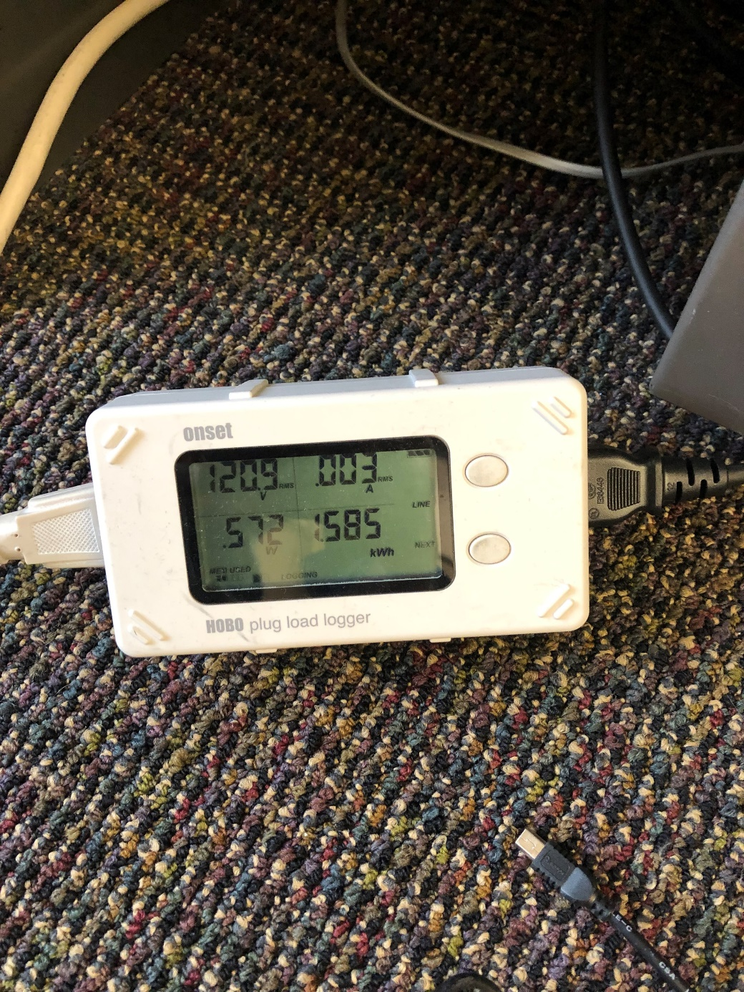
Metering and Data Collection
BMS Data
Occupancy
Lighting circuits
Plug loads
1+ year data collection
1-10 min resolution
Cloud connectivity

Slide 6
Plug Load Savings Methodology
active power
Baseline
standby power
7 AM
7 PM
Retrofit
saved energy
Notes:
Where data was available, we analyzed actual energy consumption in the baseline and post, and normalized it by schedule type to estimate annual plug load savings.
Savings are effectively the energy consumption for every time where the equipment would have been running, but was shut off because the space was unoccupied.
Most of the time this is just saving the standby power, if the equipment already has a standby power mode (which most do)

Slide 7














Plug Load Analysis Data Challenges
7 AM
7 PM
Notes:
Devices were moved to non-controlled plugs or removed from the receptacles entirely over the course of the study
COVID also prevented us from seeing real behavior
Can’t get occupancy data off the controller directly
Solution: develop an occupancy profile for each space for each hour of the day (accounting for timeout period). Apply the average occupancy reduction to actual baseline energy consumption to estimate how much energy would be saved if occupancy control were applied.

Slide 8

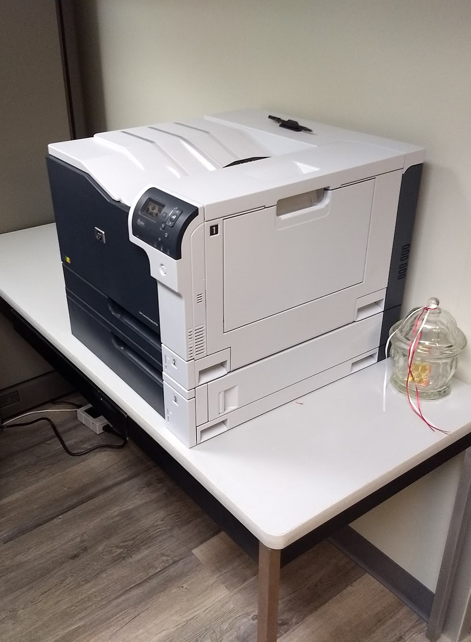
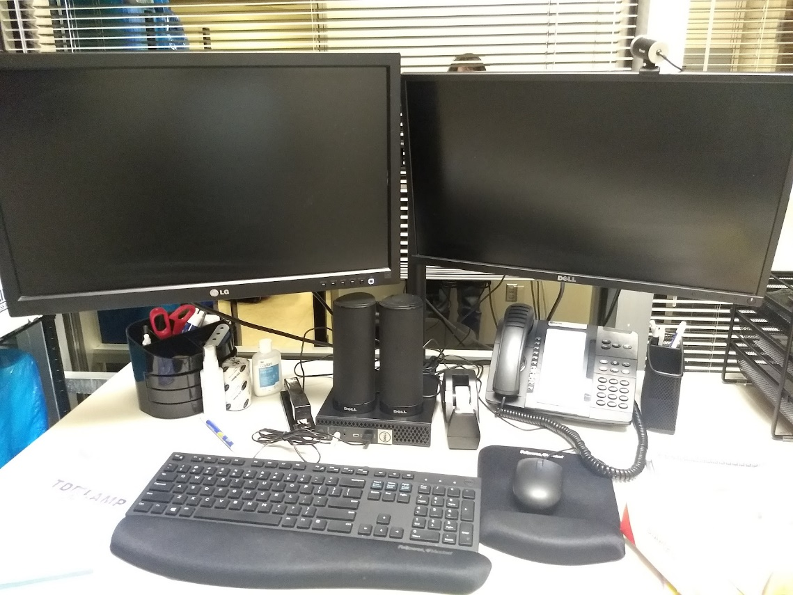
Plug Load Savings Results
Site
Plug load savings (kWh/yr)
A
353
B
1,092
C
1,975
D
1,075
E
1,083
Notes:
Comments on what controllable loads we found, and what worked well:
A lot of monitors, very low savings individually due to small standby power, but large quantity in some buildings if configured correctly
Printers and copiers had decent savings in some cases, but not large quantities, and users may want to keep them online
Exercise equipment was the most successful – high standby power, infrequent use
Discuss variation in occupancy patterns, equipment types
Estimated results: A, C
Actual results: B, D, E

Slide 9








HVAC Savings Methodology
AHU consumption:
Fan energy
Heating and cooling energy
VAV box consumption:
Hydronic reheat energy
Fan energy (if applicable)
Notes:
AHU fan savings: depends on system, but in most cases use kW/CFM curve to estimate fan power, or if VFD speed is known estimate power with affinity law or power meter
AHU heating and cooling: supply air temp - mixed air temp (delta T), flow (CFM), heating system efficiency (depends on system) or cooling efficiency. Note only sensible heat.
VAV fan: rated fan power when fan signal is on
VAV reheat: water-side calculation with rated flow, valve percentage, temperature drop
Data problems with BMS changed how we had to do the analysis

Slide 10





HVAC Analysis Data Challenges
Full baseline
and retrofit data
Weather-normalized
pre/post comparison
B
E
COVID delays and reduced operation
Runtime reduction prediction from baseline data and occupancy sensors
A
C
Incomplete trend data
No detectable savings
D
Notes:
Can’t do billing analysis because of simultaneous lighting fixture and control upgrades (and also COVID)
Missing BMS data points
Overwritten or unavailable BMS data
Unable to access BMS directly
Many different people involved made it difficult to plan
For sites A and C, we used a predictive approach by applying the occupancy sensor data to estimate when the equipment would have shut off had the occupancy controls been present in the baseline. Refer back to occupancy sensor approach for estimating behavior with occ sensor overlayed. Where full data available, we used the actual behavior.

Slide 11
HVAC Savings Results
Site
AHU Heating (kBTU/yr)
AHU Sensible Cooling (kWh/yr)
AHU Fan (kWh/yr)
VAV Reheat (kBTU/yr)
VAV Fan (kWh/yr)
A
57,244
4,676
88,689
B
1,500
C
3,003
565
83,329
5,097
D
E
2,572
4,808
122,664
14,673
17,753
Notes:
Site A: 42%, 22%, 31%
Site B: 11%
Site C: 55%, 3%, 75%, 74%
Site D: n/a
Site E: 2%, 57%, 92%, 11%, 81%
Note that savings are not representative of what you should expect for any building of that particular type – building type is just for context, the difference between HVAC systems and usage patterns have a much greater effect.

Slide 12





AHU with Variable Air Volume Zone Control
Central air handler
Exhaust air damper
Cooling coil
A
Outside air damper
Mixed air damper
B
Supply air fan (with VFD)
Primary heating coil
Supply air duct (~55°F)
C
Terminal reheat coil
VAV damper
VAV boxes
D
E
Zone A
Zone B
Zone C
Return air duct

Slide 13




AHU with Dual-Deck Zone Control
Central air handler
Exhaust air damper
Heating coil
A
Outside air damper
Cooling coil
Mixed air damper
B
Supply air fan (constant volume)
Hot air duct
Cold air duct
C
D
Linked mixing damper
E
Zone A
Zone B
Zone C
Return air duct

Slide 14

RTU with Variable Volume and Temperature Zone Control
Packaged rooftop unit
Exhaust air damper
Packaged cooling coil
A
Outside air damper
Mixed air damper
Natural gas burner
B
Bypass damper
Supply air fan (constant volume)
Supply air duct (alternates hot/cold)
C
D
Zone damper
VVT boxes
E
Zone A
Zone B
Zone C
Return air duct

Slide 15
Challenges and Solutions
COVID disruptions
Avoid scheduling M&V during an unexpected global pandemic?
BMS data issues
Review data early and often
Build draft calculations for data sanity check
Install additional instrumentation if needed
Evaluation timing
Include both heating and cooling periods
Analyze individual components
Notes:
COVID disruptions
Altered occupancy patterns, changes in operations
BMS data issues
Data access, missing trend points, overwritten logs, etc.
Evaluation timing
Cooling vs. heating seasons, simultaneous system changes
Utility billing analysis not an option due to timing of lighting changes

Slide 16
Challenges and Solutions
Long project timeline
Expect the unexpected
Design contracts for long-term engagement
Complex coordination
Identify a project champion
Meet regularly with all stakeholders
Incomplete implementation
Plan for follow-up and adjustments
Set clear acceptance criteria

Slide 17






Facility Selection for Plug Load Controls
Which devices can be shut off?
Survey actual equipment and usage to estimate realistic savings before committing to plug load controls
What is their active and standby power?
When do they go into standby mode?
How many devices are there?
Will they be tampered with?
Are occupants invested in savings?

Slide 18


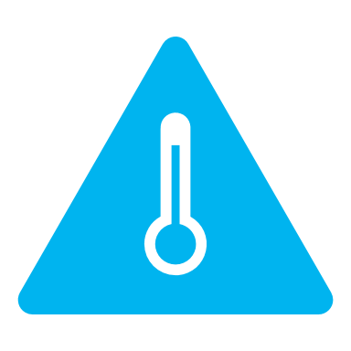



Facility Selection for HVAC Controls
Do HVAC zones correspond to occupancy patterns?
Do systems either serve single zones or have variable volume control?
How does heating/cooling source operate at reduced capacity?
How will existing control strategies be affected?
Does the BMS support integration and easy adjustment?
Are there dedicated facilities staff to maintain savings?

Slide 19




Key Takeaways
Controls integration can save a lot of energy… or barely any
Consider the details
of each building individually
Plan for evaluation early in the process
Always Be
Checking Data

Slide 20

Thank You!
Questions / Discussion
Nathan Hinkle | Associate
Cadmus
Portland, OR
nathan.hinkle@cadmusgroup.com

